Slide 1
Office Computer Application WEEK SEVEN
Muhammad Unggul Pamenang

Slide 2
Please Do It With MS PowerPoint from 2010 - 2016

Slide 3
Inserting Videos
1
MS PowerPoint 2016

Slide 4
Introduction
PowerPoint allows you to insert a video onto a slide and play it during your presentation. This is a great way to make your presentation more engaging for your audience.
You can even edit the video within PowerPoint and customize its appearance. For example, you can trim the video's length, add a fade in, and much more.

Slide 5
To insert a video from a file:
In our example, we'll insert a video from a file saved locally on our computer. If you'd like to work along with our example, right-click this link to our example video and save it to your computer.

Slide 6
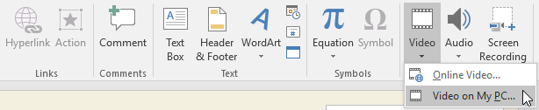
To insert a video from a file:
From the Insert tab, click the Video drop-down arrow, then select Video on My PC.

Slide 7
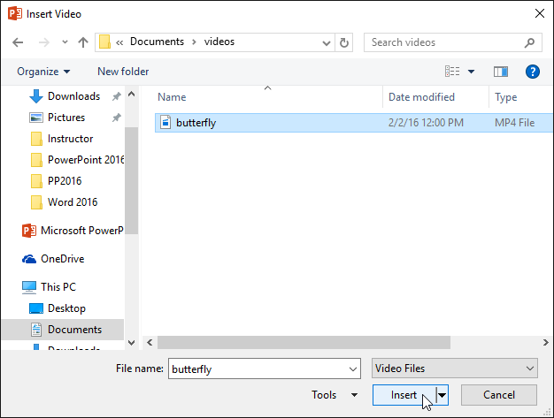
To insert a video from a file:
Locate and select the desired video file, then click Insert.

Slide 8
To insert a video from a file:
Locate and select the desired video file, then click Insert.

Slide 9

To insert a video from a file:
The video will be added to the slide.

Slide 10

To insert a video from a file:
With the Screen Recording feature on the Insert tab, you can create a video of anything you are doing on your computer and insert it into a slide.

Slide 11
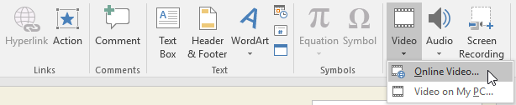
To insert an online video:
Some websites—like YouTube—allow you to embed videos into your slides. An embedded video will still be hosted on its original website, meaning the video itself won't be added to your file. Embedding can be a convenient way to reduce the file size of your presentation, but you'll also need to be connected to the Internet for the video to play.

Slide 12
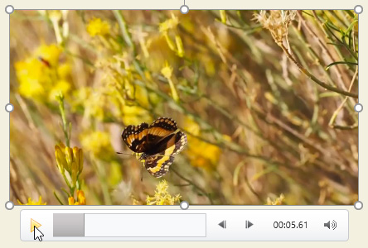
Working with videos
To preview a video:
Click a video to select it.
Click the Play/Pause button below the video. The video will begin playing, and the timeline next to the Play/Pause button will advance.

Slide 13

To preview a video:
To jump to a different part of the video, click anywhere on the timeline.

Slide 14

To resize a video:
Click and drag the corner sizing handles until the video is the desired size.

Slide 15

To move a video:
Click and drag to move a video to a new location on a slide.

Slide 16
To delete a video:
Select the video you want to delete, then press the Backspace or Delete key on your keyboard.

Slide 17
Editing and formatting videos
The Playback tab has several options you can use to edit your video. For example, you can trim your video to play an excerpt from the original, add a fade in and fade out, and add bookmarks that allow you to jump to specific points in the video.

Slide 18
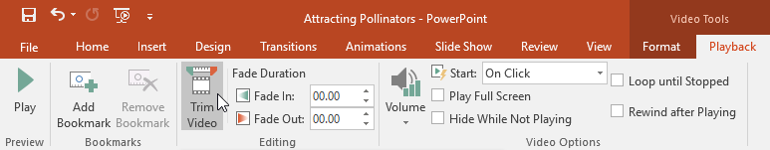
To trim a video:
Select the video, then click the Playback tab on the Ribbon.
Click the Trim Video command.

Slide 19
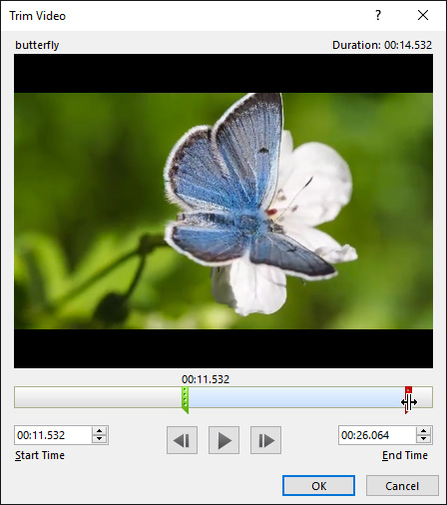
To trim a video:
A dialog box will appear. Use the green handle to set the start time and the red handle to set the end time.

Slide 20
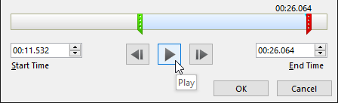
To trim a video:
To preview the video, click the Play button.
When you're done trimming the video, click OK.

Slide 21
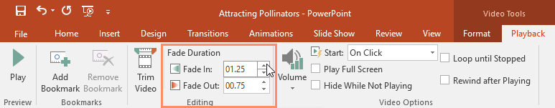
To add a fade in and fade out:
On the Playback tab, locate the Fade In: and Fade Out: fields.
Type the desired values, or use the up and down arrows to adjust the fade times.

Slide 22
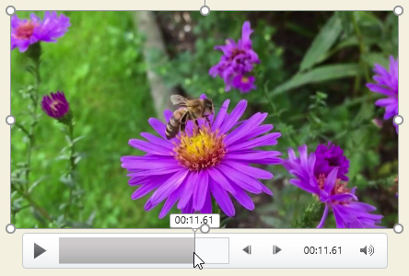
To add a bookmark:
Click the timeline to locate the desired part of the video.

Slide 23
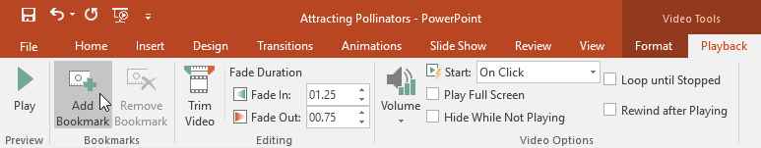
To add a bookmark:
From the Playback tab, click the Add Bookmark command.

Slide 24

To add a bookmark:
The bookmark will appear on the timeline. Click the bookmark to jump to that location.

Slide 25
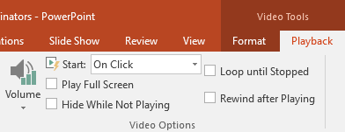
Video options
There are other options you can set to control how your video will play. These are found in the Video Options group on the Playback tab.

Slide 26
Video options
Volume: Changes the audio volume for the video
Start: Controls whether the video starts automatically or when the mouse is clicked
Play Full Screen: Lets the video fill the entire screen while playing
Hide While Not Playing: Hides the video when not playing
Loop until Stopped: Replays the video until stopped
Rewind after Playing: Returns the video to the beginning when it is finished playing

Slide 27
Formatting the appearance of a video
Like pictures, PowerPoint allows you to format the appearance of a video by applying a video style, adding a border, changing the shape, and applying various effects.

Slide 28
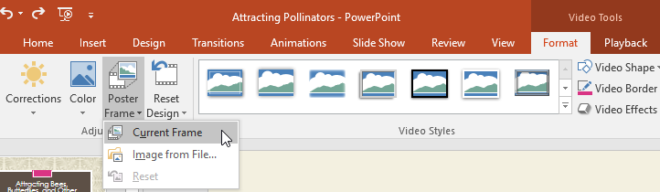
To create a poster frame:
You can add a poster frame to a video, which is the placeholder image your audience will see before the video starts playing. The poster frame is usually just a frame taken from the video itself.
Click the timeline to locate the desired part of the video.
From the Format tab, click the Poster Frame command. Select Current Frame from the menu that appears.

Slide 29

To create a poster frame:
The current frame will become the poster frame.

Slide 30
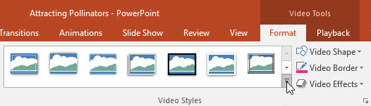
To apply a video style:
Select the video, then click the Format tab on the Ribbon.
In the Video Styles group, click the More drop-down arrow to display available video styles.

Slide 31
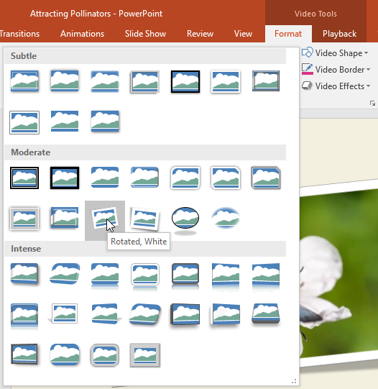
To apply a video style:
Select the desired style.

Slide 32

To apply a video style:
The new style will be applied to the video.

Slide 33
JOBSHEET
Continue working

Slide 34
THANKS!

